Slide 1
Introduction to Project Management

Slide 2
What is a Project?
A project is a temporary endeavour undertaken to create a unique product, service, or result
PMBOK Guide
Projects and operations differ primarily in that operations are ongoing and repetitive, while projects are temporary and unique.

Slide 3
Project Characteristics
  Temporary:
    means that every project has a definite beginning and a definite end. The end is reached when the project’s objectives have been achieved, or it becomes clear that the project objectives will not or cannot be met.
    Temporary does not necessarily mean short in duration, however the duration is finite.

Slide 4
  Unique products, services or results: A project creates unique deliverables, which are products, services or results. Projects can create:
    A product or artifact that is produced, is quantifiable, and can be either an end item in itself or a component item.
    A capability to perform a service, such as business functions supporting production or distribution.
    A result, such as outcomes or documents. For example, a research project develops knowledge that can be used to determine whether or not a trend is present or a new process will benefit society.

Slide 5
  Progressive Elaboration
    A characteristic of projects that accompanies the concepts of temporary and unique. It means developing in steps, and continuing by increments. E.g. The project scope will be broadly described early in the project and made more explicit and detailed as the project team develops a better and more complete understanding of the objectives and deliverables. (This should not be confused with “scope creep”).

Slide 6
Projects and operations share many of the following characteristics:
  Performed by people
  Constrained by limited resources
  Planned, executed and controlled

Slide 7


Project Constraints
Cost
Time
Scope
+
Quality
There is a fundamental tradeoff often known as the iron triangle.

Slide 8
A project (Alternative)
A project consists of the following components:
Outcome
  A work product or a group of work products. Work products produced for the customer are also called deliverables.
Work
  The work to be done to achieve the outcome. The work is broken down into units of work, which can be tasks or activities. A task is the smallest amount of work that can be managed. Tasks and activities can also be recursively grouped into higher-level activities. Work is described in work packages.

Slide 9
Schedule
  A schedule maps on a timeline the units of work performed to achieve the outcome. Units of work can depend on each other. A schedule has a start, a duration, and an end.
Resource
  The people (participants), funds, equipment and facilities required to perform the work are the project’s resources. People are grouped into an organization and assume one or more roles in the project. Each role is responsible to one or more work packages.

Slide 10
What is Project Management?
The application of knowledge, skills, tools and techniques to project activities to meet project requirements.
Project management is accomplished through the application and integration of the project management processes of initiating, planning, executing, monitoring and controlling, and closing.

Slide 11
Functional Viewpoint (Alternative)
Project Management can be defined as the process of guiding a project from the beginning through its complete duration to its end using a set of management models. Project management includes four basic activities:
  Planning
  Organizing
  Controlling
  Terminating

Slide 12
Activities
Planning
  Concerned with specifying the results to be achieved and the activities and tasks to produce these results, determining a schedule and estimating the required resources such as people and funds
Organizing
  Defines the organization of the project and the identification of roles and responsibilities. The roles are mapped to the work identified during the planning activity.

Slide 13
Activities (continued)
Controlling
  Concerned with making sure to identify when actual activities deviate from the planned ones. This involves reconfirming people’s expected performance, monitoring actions taken and results achieved, addressing problems encountered, and sharing information with people interested in the project. If a substantial deviation occurs between the planned work and the actual work, the project manager needs to reallocate resources, change the schedule, or renegotiate the outcome.

Slide 14
Terminating
  Concerned with finishing the project. It involves delivering the system to the client according to the acceptance criteria defined in the project agreement, installing the accepted system at the customer site, reviewing the project history to extract lessons learned from the project, and modifying of the project templates for the next iteration of the project or for a new project.

Slide 15
Role of Project Manager
Responsible to accomplishing the project objectives. Managing a project includes:
  Identifying requirements
  Establishing clear and achievable objectives
  Balancing the competing demands for quality, scope, time and cost
  Adapting the specifications, plans and approach to the different concerns and expectations of the various stakeholders.

Slide 16
The term “Project Management” is sometimes used to describe an organizational or managerial approach to the management of projects and some ongoing operations which can be redefined as projects, that is also referred to as “Management by projects”.

Slide 17
PMBOK Guide
The PMBOK Guide mentions the following areas:
  The standard for Project Management of a Project
  The Project Management Knowledge Areas:
    Project Integration Management
    Project Scope Management
    Project Time Management
    Project Cost Management
    Project Quality Management
    Project Human Resource Management
    Project Communications Management
    Project Risk Management
    Project Procurement Management

Slide 18
Project Integration Management
Describes the processes and activities that integrate the various elements of project management, which are identified, defined, combined, unified and coordinated within the Project Management Process Groups. It consists of the following project management processes:
  Develop Project Charter
  Develop Preliminary Project Scope Statement
  Develop Project Management Plan
  Direct and Manage Project Execution
  Monitor and Control Project Work
  Integrated Change Control
  Close Project

Slide 19
Project Scope Management
Describes the processes involved in ascertaining that the project includes all the work required to complete the project successfully. It consists of the following project management processes:
  Scope Planning
  Scope Definition
  Create WBS
  Scope Verification
  Scope Control

Slide 20
Project Time Management
Describes the processes concerning the timely completion of the project. It consists of:
  Activity Definition
  Activity Sequencing
  Activity Resource Estimating
  Activity Duration Estimating
  Schedule Development
  Schedule Control

Slide 21
Project Cost Management
Describes the processes involved in planning, estimating, budgeting and controlling costs so that the project is completed within the approved budget: Includes:
  Cost Estimating
  Cost Budgeting
  Cost Control

Slide 22
Project Quality Management
Describes the processes involved in assuring that the project will satisfy the objectives for which it was undertaken. It consists of:
  Quality Planning
  Perform Quality Assurance
  Perform Quality Control

Slide 23
Project Human Resource Management
Describes the processes that organize and manage the project team. It consists of:
  Human Resource Planning
  Acquire Project Team
  Develop Project Team
  Manage Project Team

Slide 24
Project Communications Management
Describes the processes concerning the timely and appropriate generation, collection, dissemination, storage and ultimate disposition of project information. It consists of:
  Communications planning
  Information distribution
  Performance reporting
  Manage Stakeholders

Slide 25
Project Risk Management
Describes the processes concerned with conducting risk management on a project. It consists of:
  Risk Management Planning
  Risk Identification
  Qualitative Risk Analysis
  Quantitative Risk Analysis
  Risk Response Planning
  Risk Monitoring and Control

Slide 26
Project Procurement Management
Describes the processes that purchase or acquire products, services or results, as well as contract management processes. It consists of:
  Plan Purchases and Acquisitions
  Plan Contracting
  Request Seller Responses
  Select Sellers
  Contract Administration
  Contract Closure

Slide 27
Organizational Cultures and Styles
Most organizations have developed unique and describable cultures. These cultures are reflected in numerous factors, including but not limited to:
  Shared values, norms, beliefs, and expectations
  Policies and procedures
  View of authority relationships
  Work ethic, and work hours

Slide 28
Organizations
An organization consists of organizational units and interactions between them. The smallest organizational unit is a participant (also called a person or member).
A group of participants can be organized into a division, department, or team.
Project based organization – one in which participants are assigned to only one project at a time for the duration of the project.
A project based organization consists of a dynamically changing set of projects, which are created on request and terminated when the outcome is delivered. None of the projects are permanently part of the organization.

Slide 29
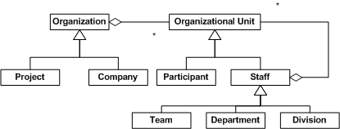
Organizations

Slide 30
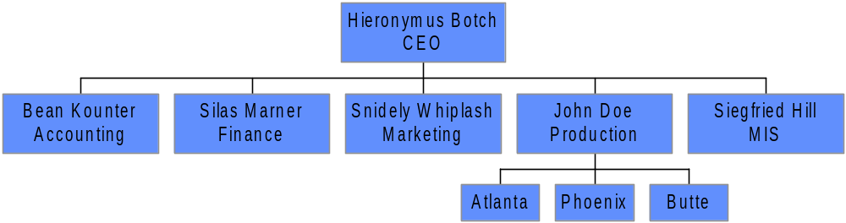
Functional Organization
(Line Organization)
Participants are grouped by their specialities. The organizational units are called departments
Each department is organized hierarchically and led by a department head.
In a line organization the projects proceed through a pipeline from one department to the next, so few participants are involved for the project’s duration.
The line organization is a fixed structure because all departments are permanently part of the organization

Slide 31
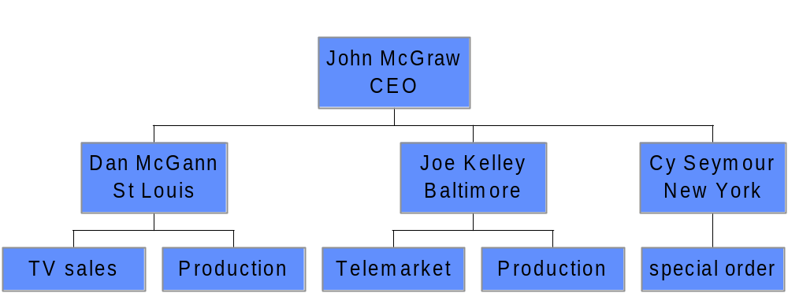
Geographic Differentiation

Slide 32
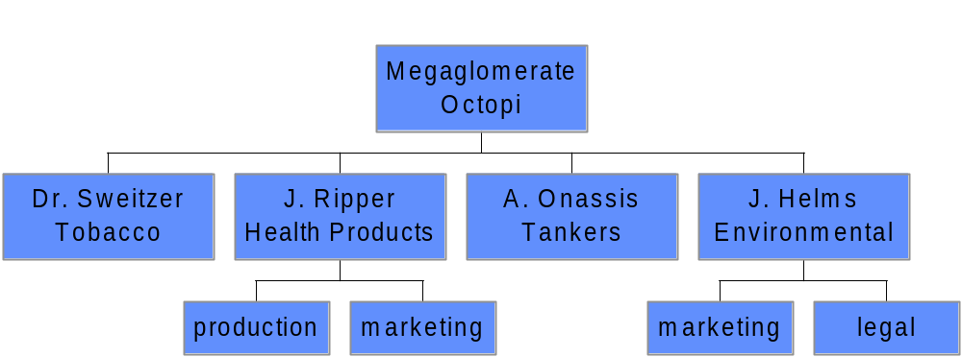
Product Differentiation

Slide 33
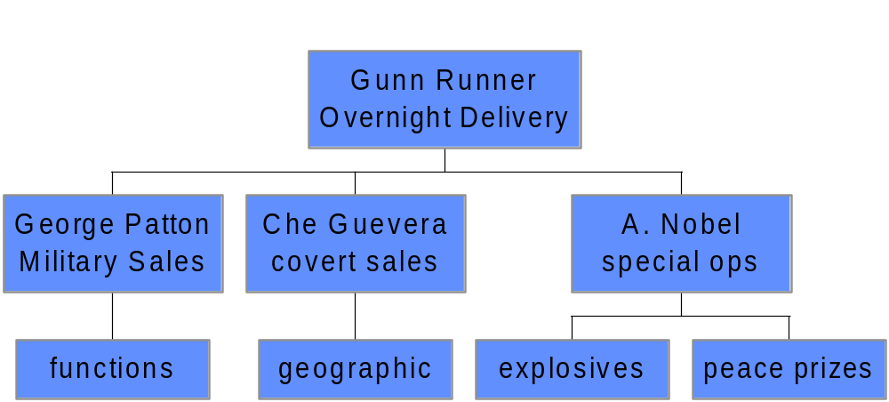
Customer Differentiation

Slide 34
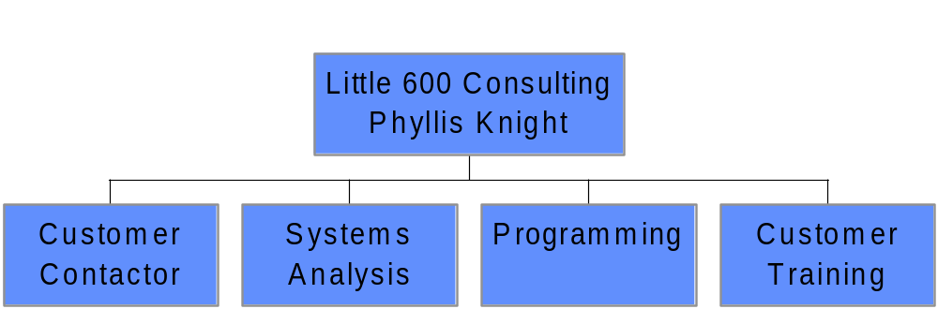
Process Differentiation

Slide 35
Matrix Organization
Combines the characteristics of functional and project-based organizations
People from different departments of the organization are assigned to work on projects as they are created.
The project manager and project members are usually assigned to these projects for less than or equal to 100% of their time.
When the participant’s involvement with the project ends, they go back to their departments and work, or are reassigned to another project.

Slide 36
Matrix Organization
Has several reporting structures, one for department and one for each of the projects. As a result each project member reports to two people, the department head and the project manager.
This violation of Fayol’s “unity of command” is a major disadvantage.
A matrix organization allows rapid response to project needs and easy recruitment of people with special skills.

Slide 37
Project Organizations
need to be highly differentiated to meet variety of problems
need to be highly integrated to respond rapidly
need to be highly flexible
must integrate subunits through horizontal relationships
must have structures suited to unique environments

Slide 38
Management
(Henri Fayol’s viewpoint)
To be Prevoyant
  (Forecast and Plan). Examining the future and drawing up a plan of action. The elements of strategy
To organize
  Build up the structure, both material and human, of the undertaking
To command
  Maintain the activity among the personnel
To coordinate
  Binding together, unifying and harmonizing all activity and effort
To control
  Seeing that everything occurs in conformity with established rules and expressed commands

Slide 39
Management Principles
Henri Fayol:14 Principles
Specialization of labor. Specializing encourages continuous improvement in skills and the development of improvements in methods.
Authority. The right to give orders and the power to exact obedience.
Discipline. No slacking, bending of rules.
Unity of command. Each employee has one and only one boss.
Unity of direction. A single mind generates a single plan and all play their part in that plan.
Subordination of Individual Interests. When at work, only work things should be pursued or thought about.
Remuneration. Employees receive fair payment for services, not what the company can get away with.
Centralization. Consolidation of management functions. Decisions are made from the top.
Scalar Chain (line of authority). Formal chain of command running from top to bottom of the organization, like military
Order. All materials and personnel have a prescribed place, and they must remain there.
Equity. Equality of treatment (but not necessarily identical treatment)
Personnel Tenure. Limited turnover of personnel. Lifetime employment for good workers.
Initiative. Thinking out a plan and do what it takes to make it happen.
Esprit de corps. Harmony, cohesion among personnel.

Slide 40
Henry Mintzberg on Management

Slide 41
Quotes
“…it is surprising how little study there has been of what managers actually do”
“There has certainly been no shortage of material on what managers should do … Unfortunately, in the absence of any real understanding of managerial work, much of this advice has proved false and wasteful. How can anyone possibly prescribe change in a phenomenon so complex as managerial work without first having a deep comprehension of it?”

Slide 42
Henry Mintzberg’s Managerial Roles
Interpersonal Roles
  Figurehead
  Leader
  Liaison
Informational Roles (40%)
  Monitor
  Disseminator
  Spokesperson
Decisional Roles
  Entrepreneur
  Disturbance Handler
  Resource Allocator
  Negotiator

Slide 43
Mintzberg views the ten roles as inseperable. They form a gestalt (i.e., the integrated whole is greater than the sum of its parts)

Slide 44
Figurehead
By virture of his/her position as head of an organizational unit, every manager must perform some ceremonial duties. These can include lunch with important customers, attending weddings of employees, and meeting with touring dignitaries. Some appear trivial but are important to the smooth functioning of an organization. Project managers have a certain number of these functions to carry out. So this finding applies to project managers as well as to general managers.

Slide 45
Leader
Being in charge of an organizational unit, the manager is responsible for the work of the people in that unit. There many be both direct and indirect leadership roles to perform. Encouraging and motivating members of a project team would be a direct role in a pure project organization, and an indirect role in a matrix. Project managers usually have a lot of responsibility but little formal authority, so they must use influence to get things done. Leadership involves a great deal of influence activity, so it is one of the most important roles for the project manager.

Slide 46
Liaison
A role in which the manager makes contacts outside of his or her vertical chain of command. There is no doubt that project managers engage in this role to a great extent. Some people call this the boundary-crossing role, because managers work outside the boundaries of their immediate unit. In fact, interfacing with people outside the unit is critical to the success of project teams. One of the major functions of such interfacing is to gather information. In effect, the liaison role is devoted to building up the manager’s own external information system – informal, private, oral, but nevertheless effective.

Slide 47
Monitor
The manager is always scanning the environment for information. Much of the information that the manager receives is in oral form and consists of gossip, hearsay, and speculation. This soft information can be very important in alerting the manager to problems before they occur.

Slide 48
Disseminator
Managers must disseminate information, or it is of no use to the team. This is one area in which some managers fail, because realizing that information is power, they try to keep it to themselves. The net result is that decisions cannot be made effectively by other members of the team, but must be made by the manager.

Slide 49
Spokesperson
A role in which managers pass information to people outside their units. This includes making presentations to higher-ranking managers, clients and sometimes to stockholders who are concerned about a major project.

Slide 50
Entrepreneur
A role of trying to improve the unit. In the monitor role, the manager is constantly on the lookout for good ideas. When one is found, the manager may initiate a development project – this is the entrepreneur role. Even project managers may occasionally play this role, suggesting projects to senior managers. This would be especially true of technical project managers, who think of applications for technology and suggest new product development projects. Corporations are also found doing new business development projects, implying that project managers are fully engaged in entrepreneurial roles.

Slide 51
Disturbance handler
Managers are initiators in the entrepreneurial role. In the disturbance handler role, they are reacting to pressures in which change is outside their control. For the project manager, this can take the form of changes in scope, accidents, loss of key personnel and conflicts with functional managers over priorities.

Slide 52
Resource allocator
This might be more the domain of the functional manager than the project manager, but even project managers have resposibility for deciding who will get what in the project team. One of the most important resources that the manager allocates is his/her time. Access to a manager exposes the person to the team’s nerve center and decision maker.

Slide 53
Project Management Concepts
The basic assumption of project planning is that the project outcome cannot be produced by a single monolithic activity. One of the key tasks therefore is to decompose the total work package into smaller tasks. This involves two things:
  Identifying appropriate tasks and
  identifying dependencies between tasks.
A hierarchical representation of all the tasks in a project is called the work breakdown structure (WBS).
We then talk about the representation of temporal dependencies between tasks, which is called the task model or network diagram. The task model is then mapped onto a time line which is the project schedule.

Slide 54
Tasks and activities
Task
  A task is a well defined work assignment for a project participant or a team. A task is the smallest unit of work that is subject to project management.
  A task includes a description and a duration, and is assigned to a role filled by a participant.
  Tasks consume resources and produce one or more work products. They often consume work products produced by other tasks.

Slide 55
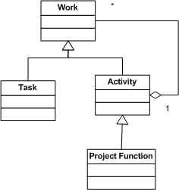

Slide 56
Work Products, Work Packages, and Roles
A manager assigns tasks, activities and project functions to participants or a team to carry out.
The manager monitors the progress and completion of the work.
In small projects this can be done informally, in larger projects this must be spelled out more explicitly in the form of work packages.

Slide 57
Work Products, Work Packages, and Roles
A work package describes:
  the work products to be produced,
  the resources needed to perform the work,
  the expected duration
  Dependencies on inputs, which are work products produced by other tasks as well as dependencies on other tasks.
  It also specifies the acceptance criteria and the name of the responsible individual or organizational unit

Slide 58
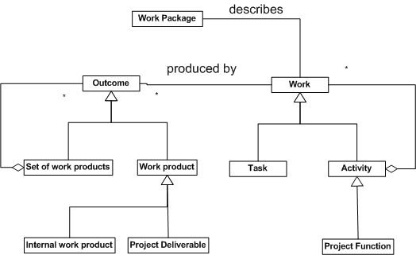

Slide 59
Work packages can be specified right after the tasks have been identified. An example is
  An action item, which contains only the name of the participant, the description of the task to be performed and time it must be completed by.
  Larger work packages are descriptions for creating an object model, a class diagram, source code, a document section, or a document. E.g. Each section of the requirements analysis document can correspond to a work package specifying who has to write the section and by when.
  Any work product to be delivered to the customer is called a deliverable. The software system and the accompanying documentation, e.g. user manual, are deliverables. All other types of work products consumed only by other project participants are called internal work products. E.g. action items are internal work products.

Slide 60
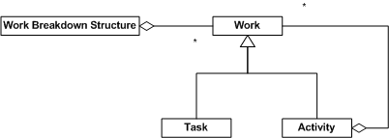
Work Breakdown Structure (WBS)
The hierarchical representation of all the tasks in a project is called the work breakdown structure.
This is a simple model of the work to be performed because it uses only aggregation to model all the identified tasks.

Slide 61
Task Model
Tasks are related by temporal dependencies. I.e. some tasks must take place before others can be begin.
Tasks have a duration, which corresponds to the actual time needed to complete the tasks given the number of required participants.
Durations are estimated by the project manager before the project starts.
Once dependencies among tasks and task durations are known, the project manager can compute the shortest possible time in which the project can be completed.

Slide 62
This is simply the longest path in the task model, called the critical path.
The project manager focuses on the tasks on the critical path, as any delay in these tasks results in delays of the overall project and missed deadlines. A task’s slack time is the maximum amount of time a task can be postponed without delaying the rest of the project.
By definition, tasks on the critical path have zero slack time.

Slide 63
Skill matrix
Once the WBS has been formulated, the project manager has to find the right participants to perform the individual tasks.
A skills matrix is a convenient form of relating the skills, knowledge and interests of people to the tasks to be performed on a project.
The rows denote units of work – tasks, activities, and project functions – from the work breakdown structure,
the columns denote project participants

Slide 64
Skills Matrix
Primary skill secondary skill interest
Tasks\Participant | John | Mary | Kofi | Robert
Control Design |  |  | ❒  | ❒
Database Design | ❒ | ❒ |  | 
User Interface Design |  |  |  | ❒ 
Configuration Management |  |  |  | ❒

Slide 65
Skills Matrix
The rows denote units of work – tasks, activities, and project functions – from the work breakdown structure,
the columns denote project participants
  A primary skill or knowledge qualifies a person to lead a unit of work.
  A secondary skill or knowledge qualifies a person to participate in a task.
  Interest means the person is interested but has no skill in a task.

